Slide 1
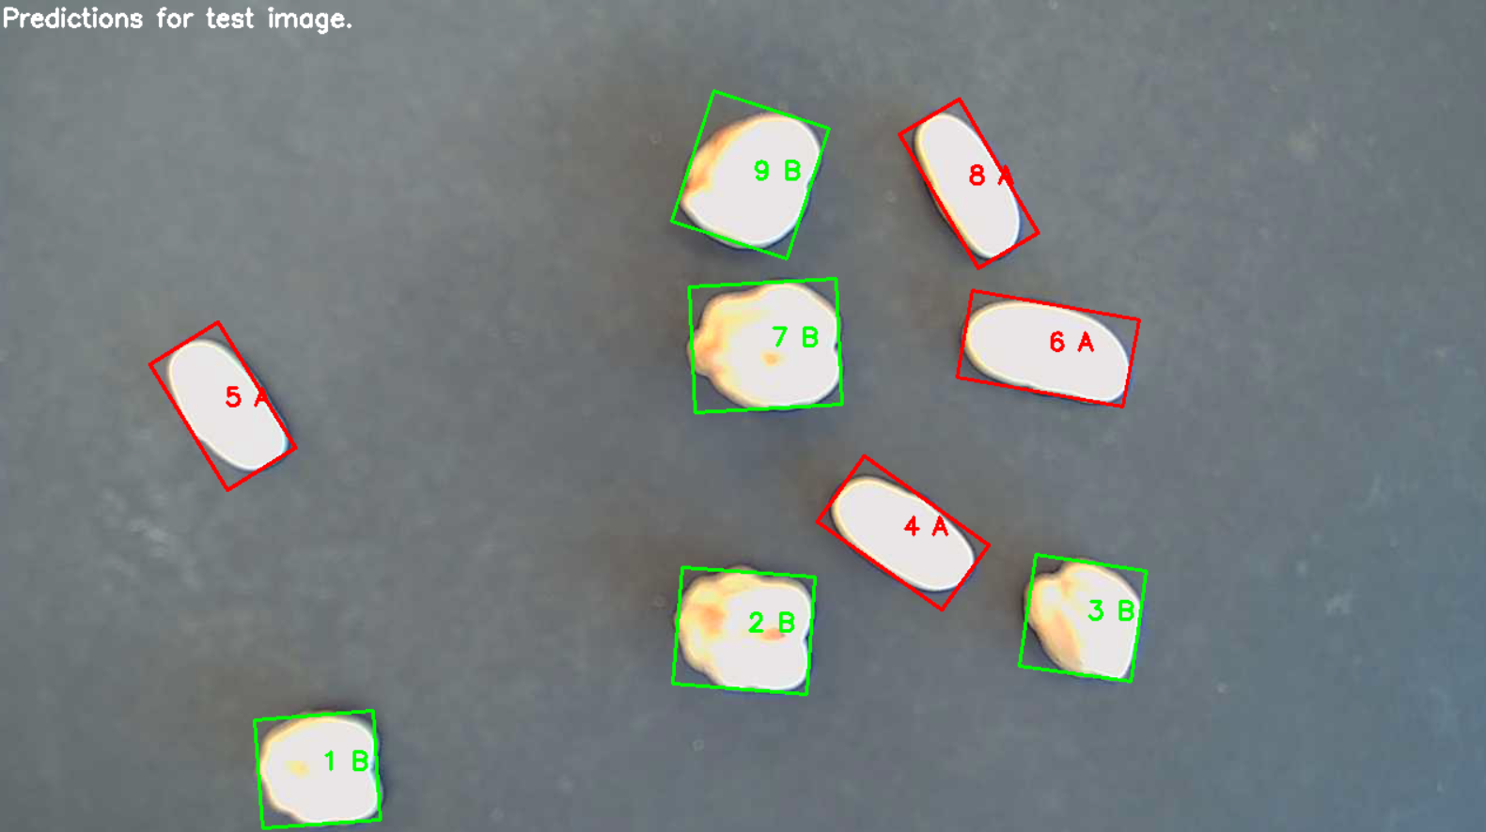
VA Project - Phase 2 - Classification
Project members:
Malcolm Sædén
Morris Steve Kungu
Ole Magnus Lærum
Techniques used:
Aspect Ratio
Bayes Mean & Variance
Bayes Mean & Covariance
K-NN

Slide 2
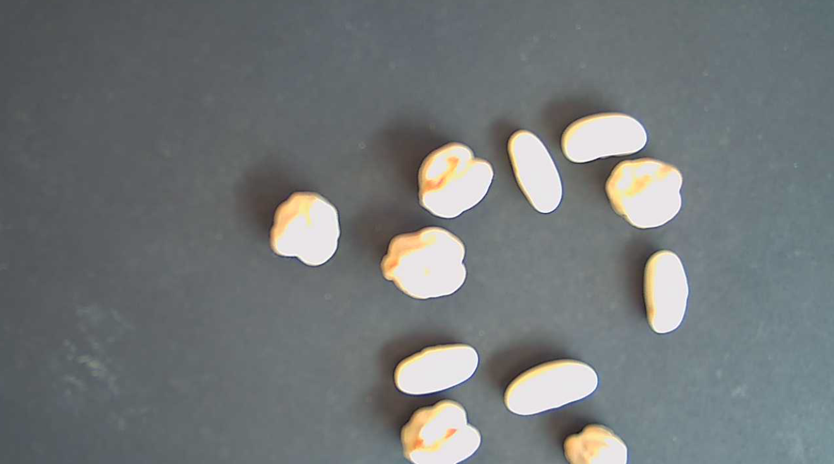
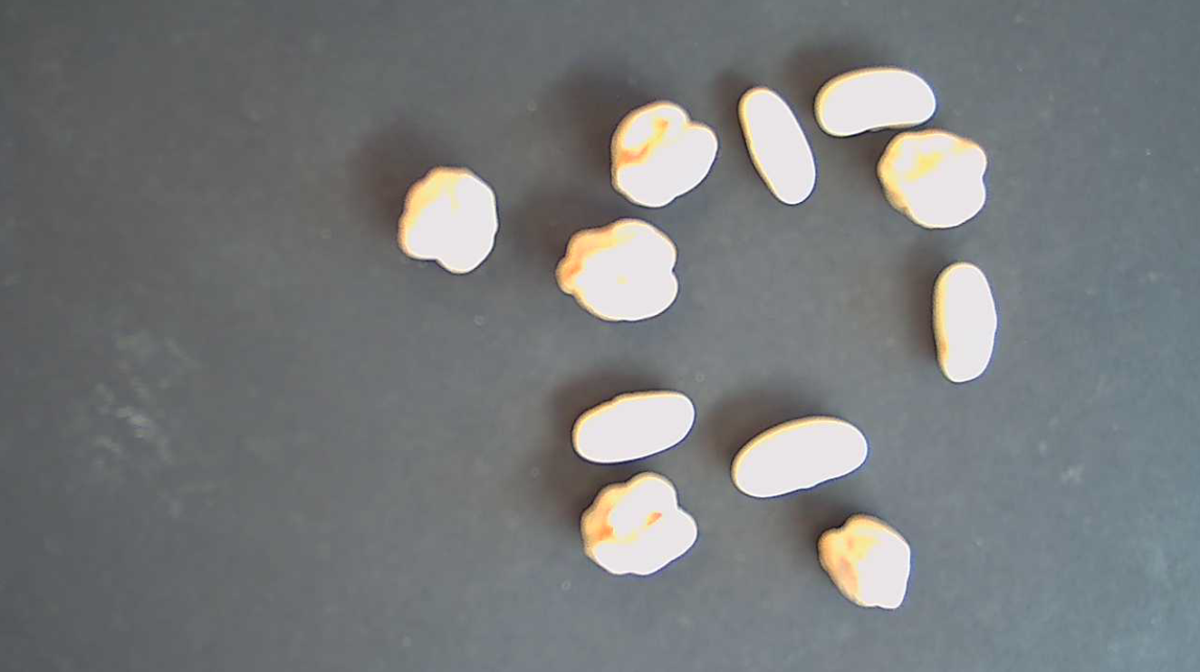
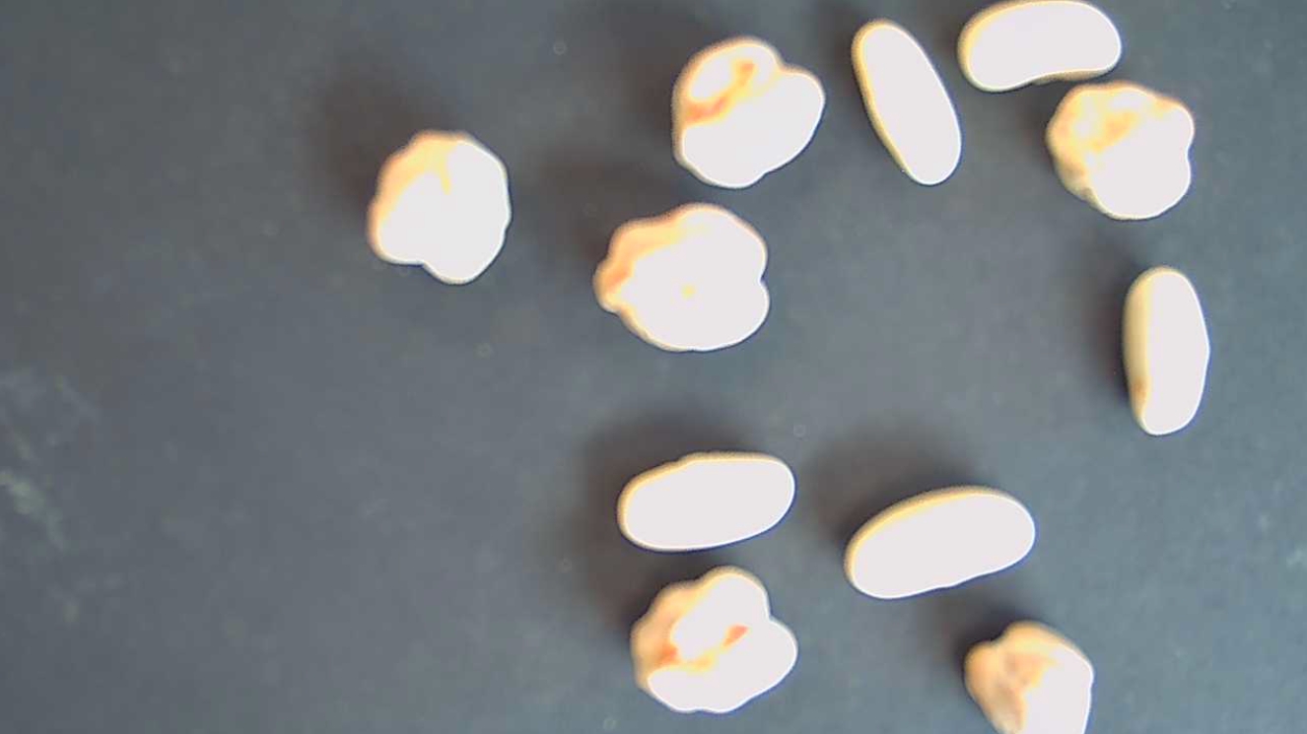
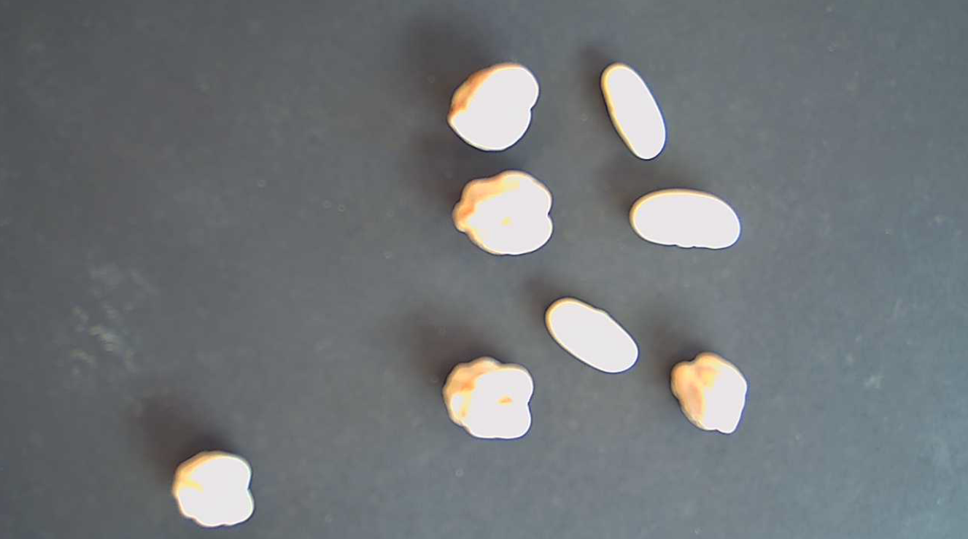
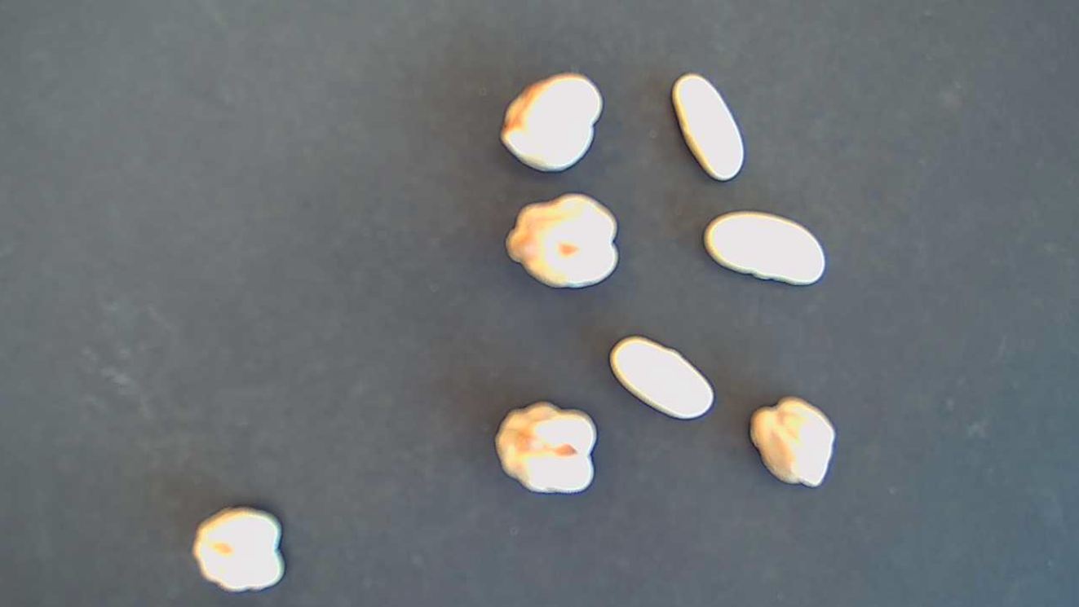
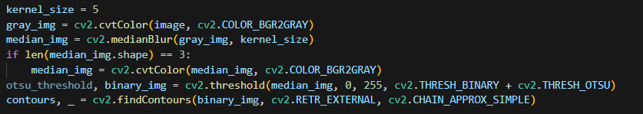
Image Acquisition and Image Preprocessing
Re-used techniques from phase 1:
Gray-scale
Median filter
Otsu threshold
Contours
Goal:
🎯🎯Find objects of interest🎯🎯

Slide 3
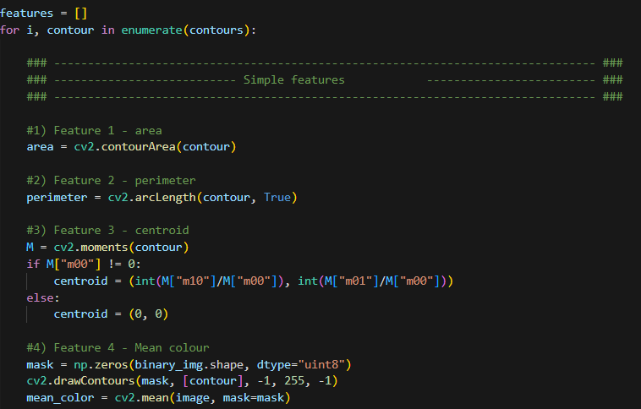
Simple feature extraction
For each 🎯Object of interest (contour)🎯:
Area
Perimeter
Centroid
Color

Slide 4
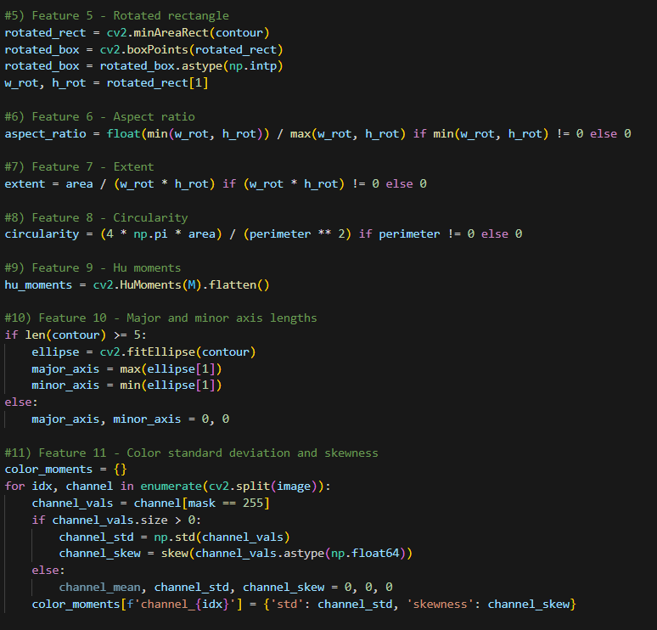
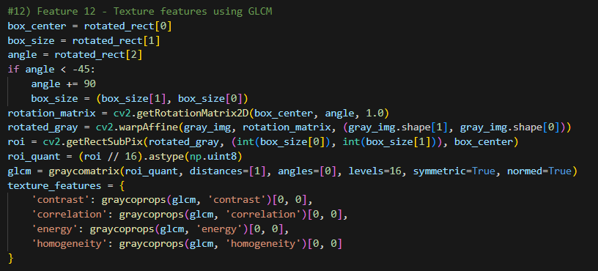
Complex feature extraction
Rotated rectangle
Aspect ratio
Extent
Circularity
Hu moments
Ellipse
Major axis
Minor axis
Color Moments
Standard deviation (per RGB)
Skewness (per RGB)
GLCM
Contrast
Correlation
Energy
Homogeneity

Slide 5
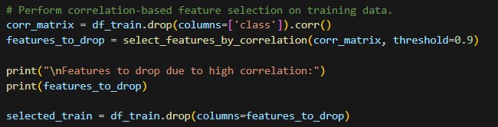
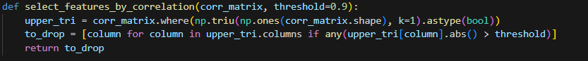
Selecting features
Flatten the features
Correlation
High correlation -> Remove
Dropping:
Perimeter
Circularity
Hu_moment_0
Hu_moment_1
Color_skewness_0
Color_std_1
Color_skewness_1
Texture_energy
Keeping:
area
aspect_ratio
extent
hu_moment_2
hu_moment_3
hu_moment_4
hu_moment_5
hu_moment_6
major_axis
minor_axis
color_std_0
color_std_2
color_skewness_2
texture_contrast
texture_correlation
texture_homogeneity

Slide 6
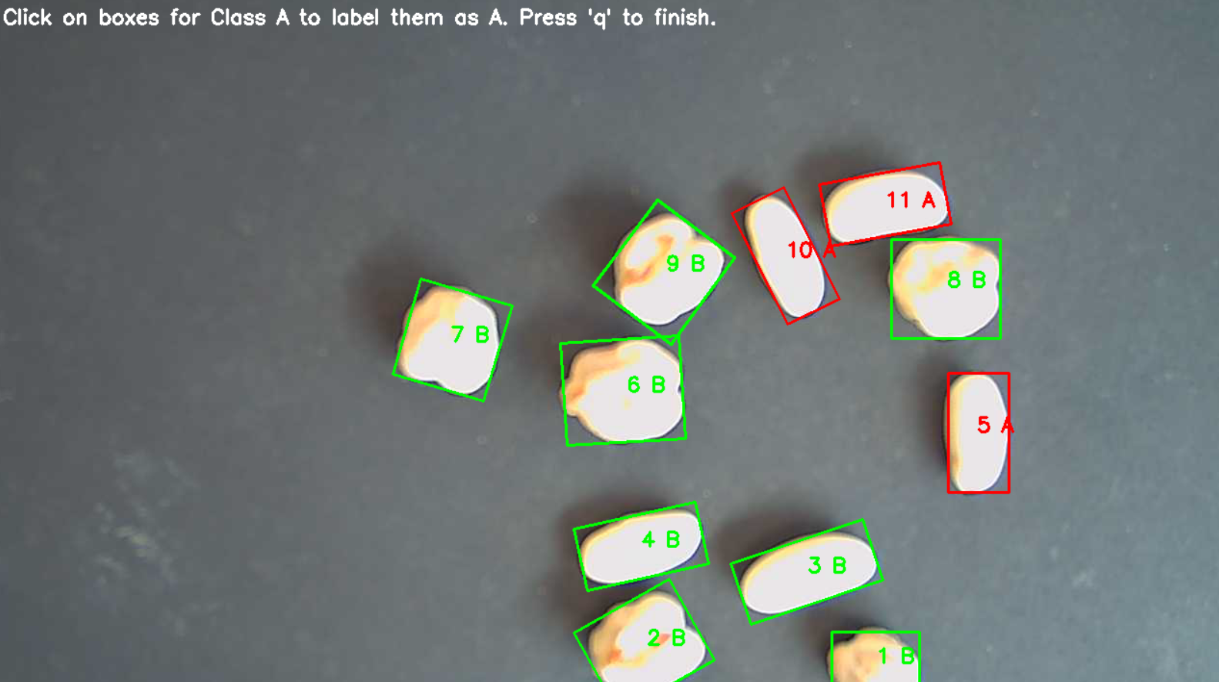
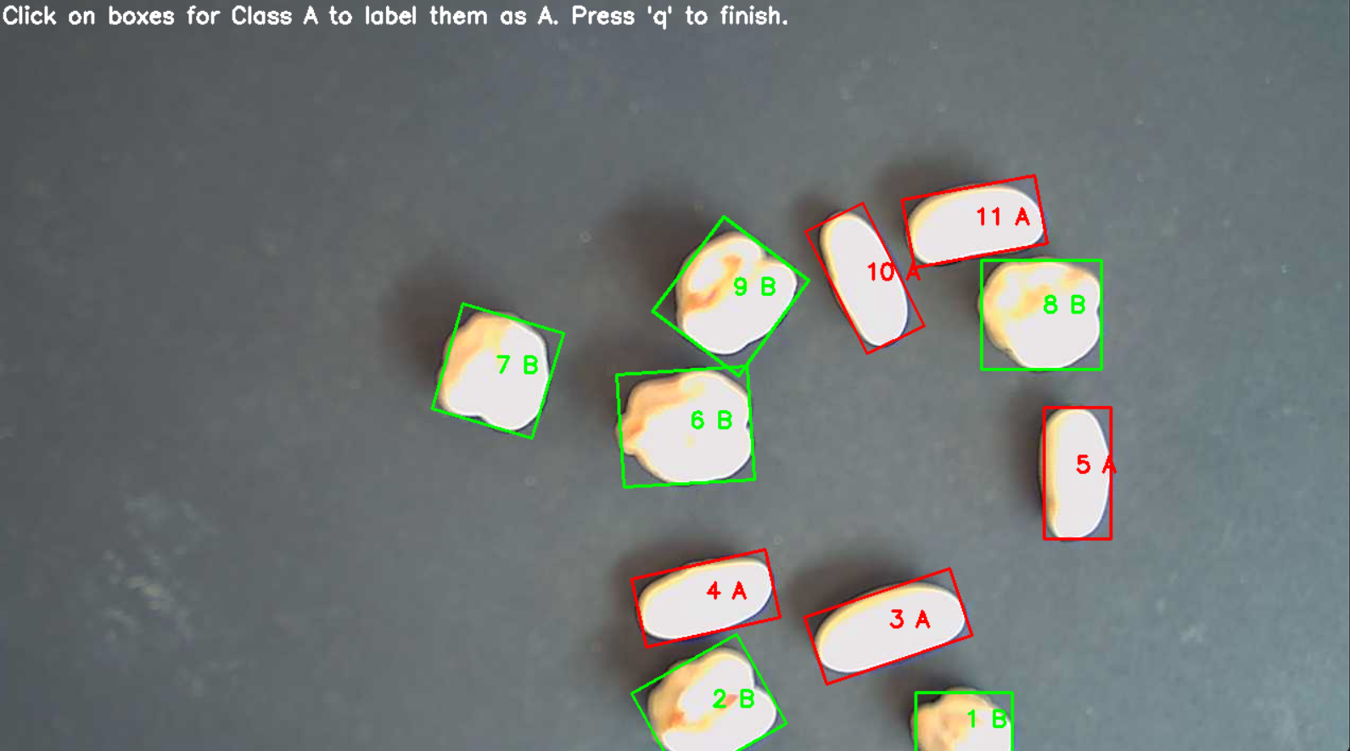
Training & Labeling
​
Manual labeling for 5 images
Save 1 photo for testing
Use labels to determine class
A or B
y = f(X)
X --> features
Y --> label/class
​

Slide 7
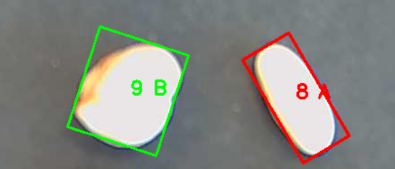
Method 1 - Aspect Ratio Classifier
Training
Finding a cutoff-value
Midpoint between mean of classes Aspect Ratio
Predicting
Aspect Ratio bigger or smaller than cutoff value?

Slide 8
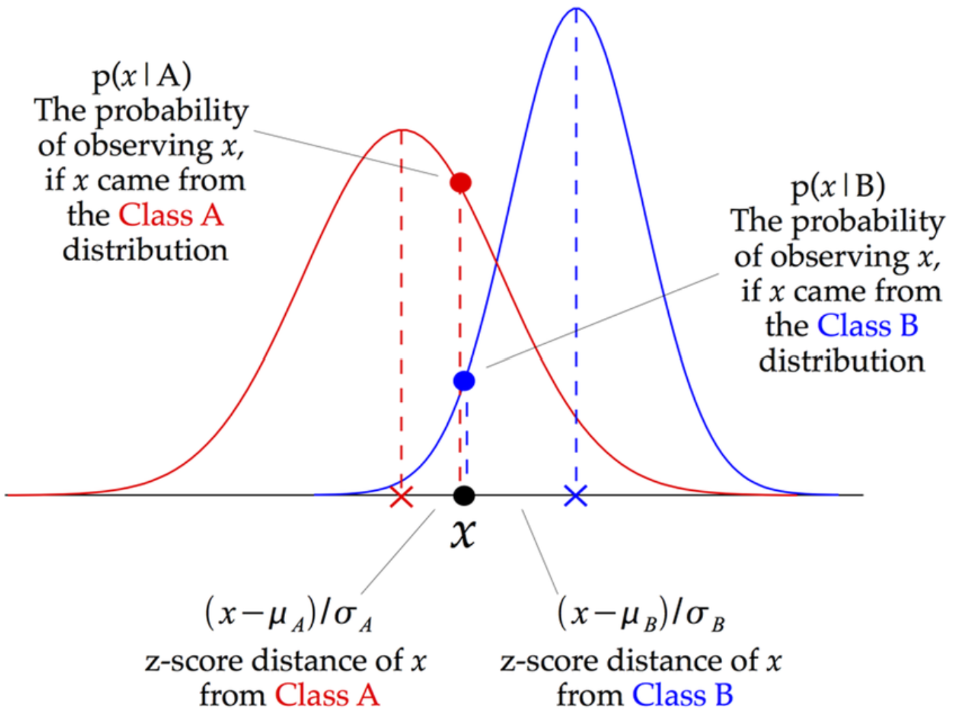
Method 2 - Generative Bayes Classifier
Gaussian Naive Bayes
Assumes each feature is independent
Ignores correlations between features
Bell curve
Only variance & mean
Full Covariance Gaussian Bayes
Uses full covariance matrix
Multivariate normal distribution cloud
Covariance & mean
Mean and variance/covariance of features

Slide 9
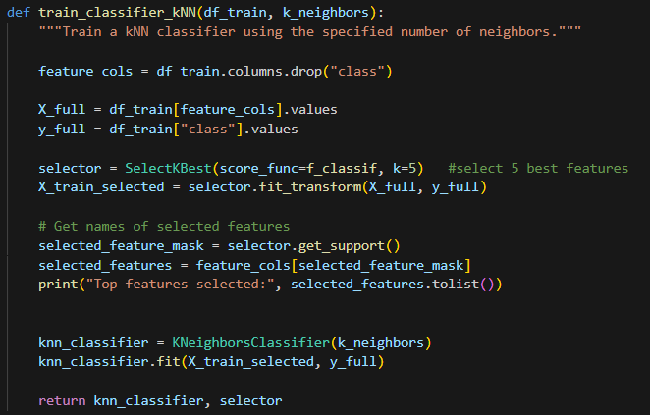
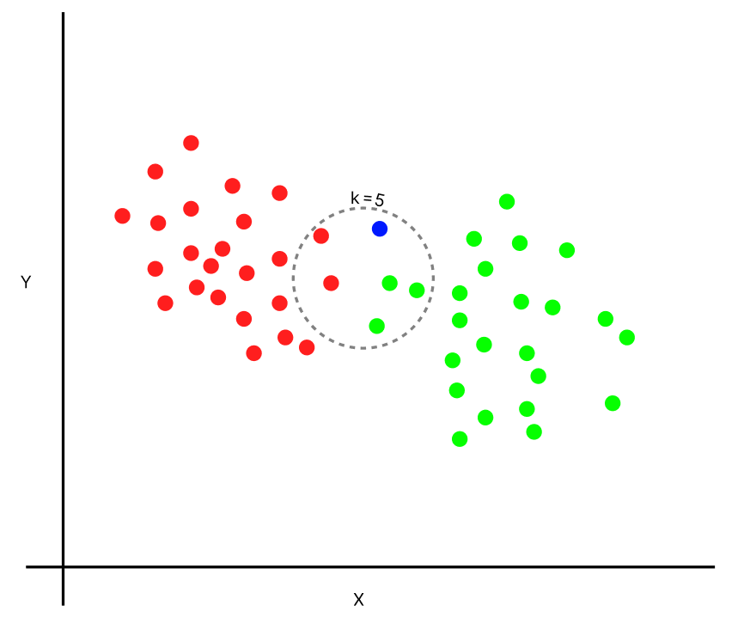
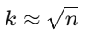
Method 3 - K-NN Classifier
Selects BEST 5 features ​
ANOVA F-statistics
Classifies object depending on nearest neighbor
Quality of result varied with k_neighbors
Max 49 ​-> because n = 49
[7, 40] works
9 seemed a good value

Slide 10
1) Aspect Ratio✅
4) kNN✅
2) Bayes Simple✅
3) Bayes Complex✅
Thank you for listening!

